Slide 1

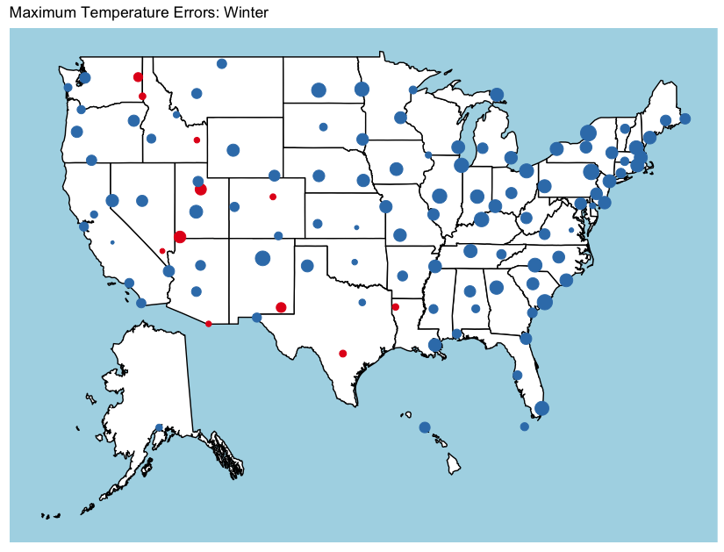
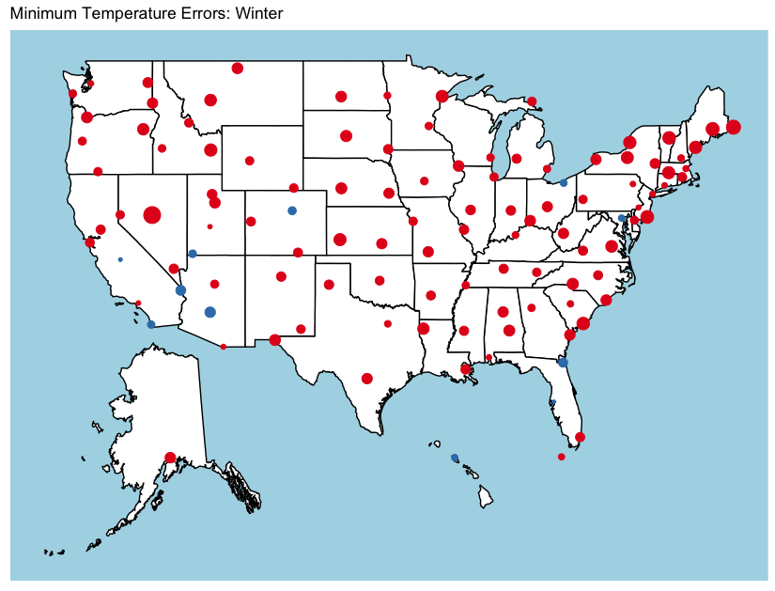
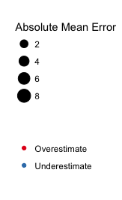
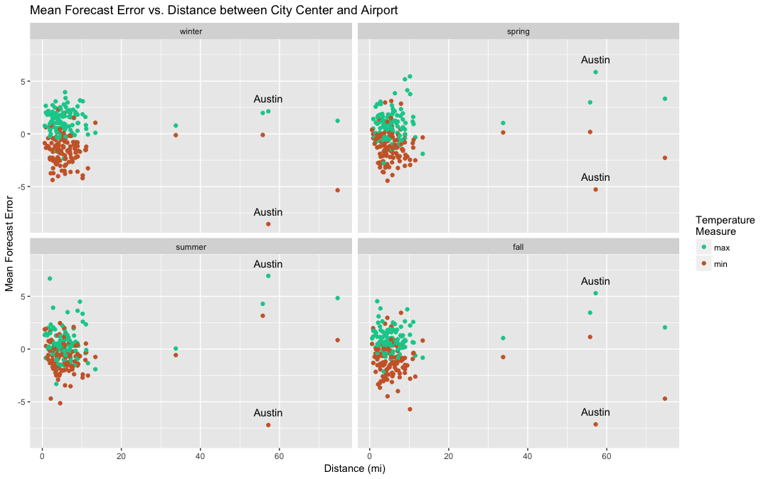
Our Title
Matt Higham, Erin Howard
Department of Statistics, Oregon State University
Model Error Graphic
BACKGROUND
Blurb
Map blurb
Distance blurb
\
Over/under blurb
Variance vs bias graphic
Variance bias blurb

